Slide 1
AI STORY GENERATOR
By : Vishakha Durbhatkar

Slide 2
INTRODUCTION
The AI Story Generator is a web application that generates creative stories based on user prompts. Built with Flask (Python) for the backend and styled with Tailwind CSS, it integrates OpenAI’s GPT-3.5 model for AI-powered story generation.
While designed for live AI responses, mock data is used as a fallback to ensure functionality in scenarios where API usage is limited. This project showcases the potential of AI in storytelling and serves as a practical example of AI integration into modern web applications.

Slide 3
PROBLEM statement and solution
Problem: Writing creative stories can be time-consuming and requires effort and imagination.
Solution: An AI-powered web app that takes user prompts and generates creative stories automatically.

Slide 4
FEATURES
User Input: Users can type any prompt to describe their desired story.
Story Generation: AI generates a unique story based on the given prompt.
Simple Interface: A clean and intuitive web design for easy interaction.

Slide 5
Technical Overview
Frontend
HTML
Tailwind CSS
JAVASCRIPT
Backend
Flask (Python)
AI Integration
OpenAI’s GPT 3.5
Development Tools
Python
Flask
Postman
Git

Slide 6
Application Workflow
User Input: The user enters a story prompt in the input field.
Backend Processing:
Flask handles the prompt and sends it to the OpenAI API.
If the API is unavailable (as in this demo), mock data is used.
Story Output: The generated story is displayed on the web page.

Slide 7
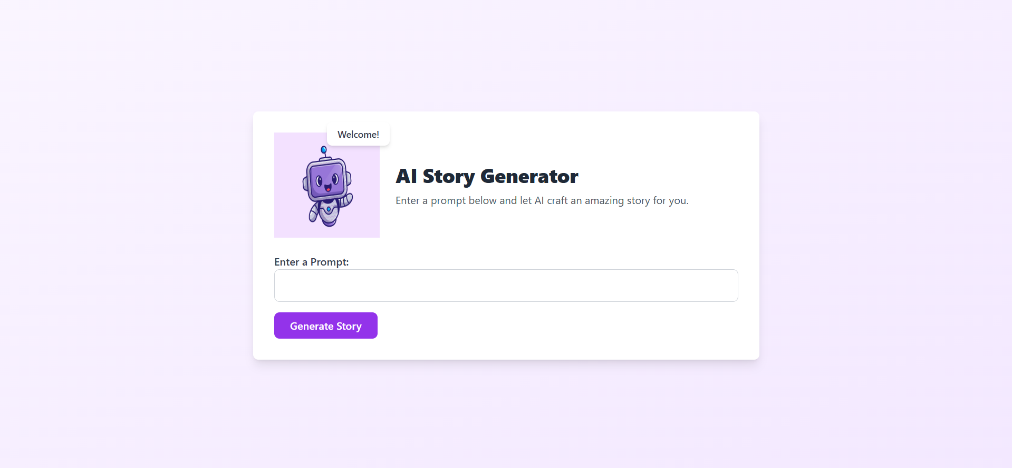
INTERFACE

Slide 8
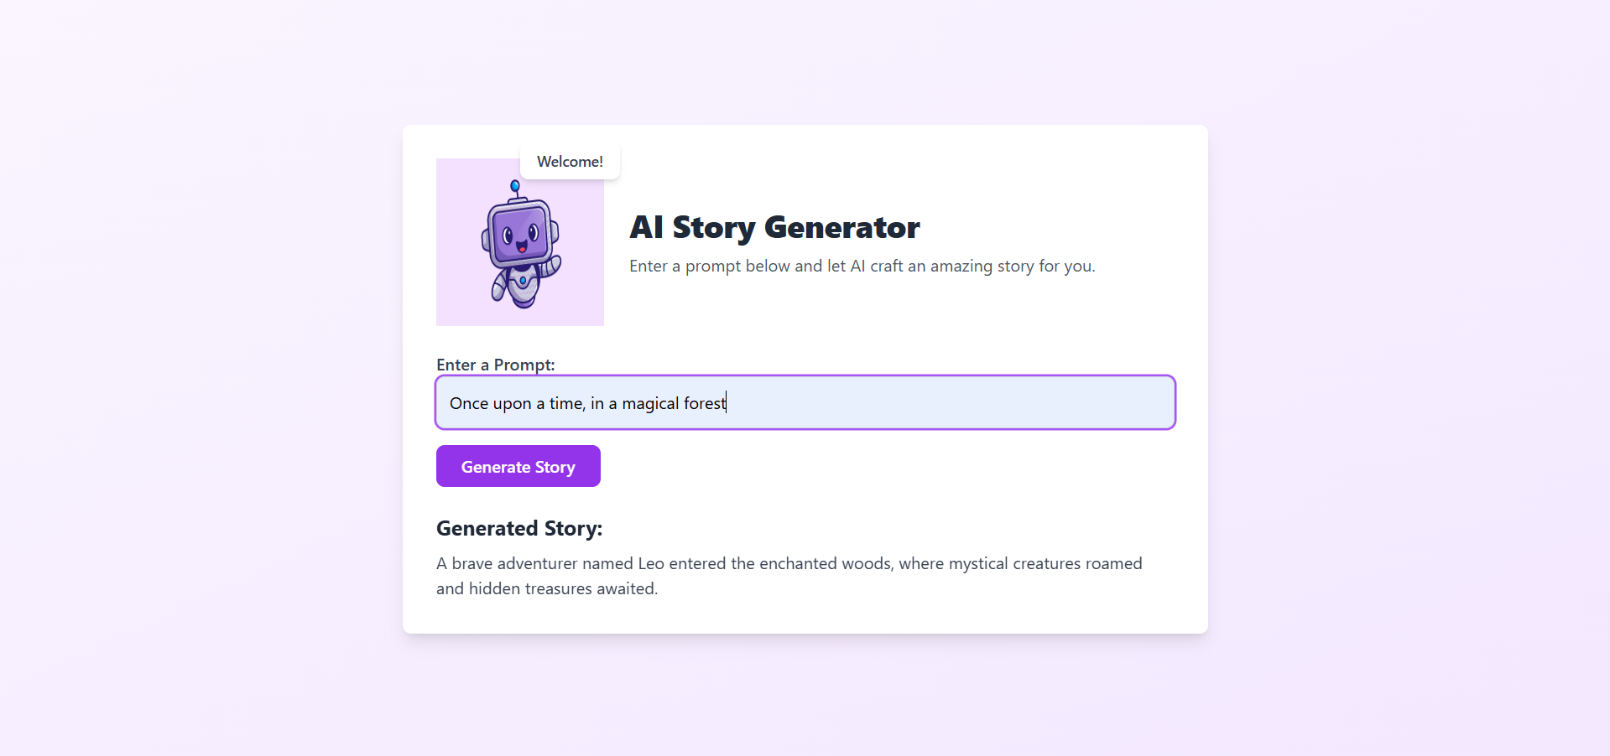

Slide 9
Key Learnings and Challenges
Learnings:
Using Flask to build a backend API.
Integrating OpenAI’s GPT-3.5 for AI-generated content.
Styling the frontend with TailwindCSS.
Challenges:
API quota exceeded during development.
Debugging frontend-backend communication.

Slide 10
CONCLUSION
Summary: The AI Story Generator simplifies storytelling by automating the creative process using AI.

